Slide 1
Regional Air Quality Modeling
Daniel Tong
November 17, 2020
CLIM 670 Earth System Modeling (Prof. Pegion)
George Mason University

Slide 2
Outline
1) Fundamentals of air quality;
2) Concepts of regional air quality modeling;
3) Typical applications;
4) CMAQ Lab Experiment: Wildfire Forecasting;

Slide 3

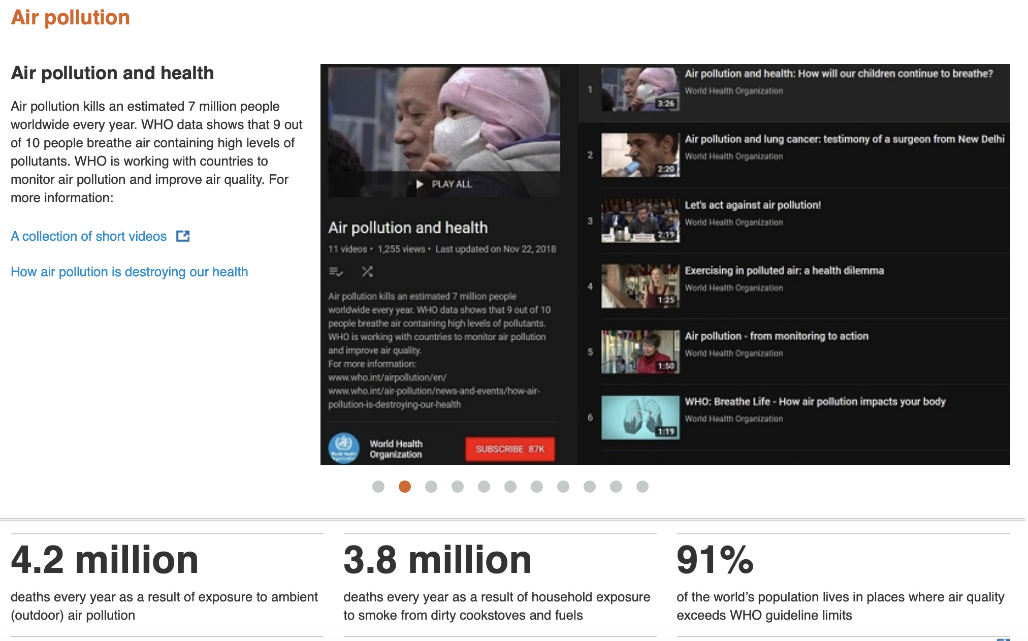

Slide 4
Criteria Air Pollutants
Aerosols
PM_{2.5} | Particulate Matter smaller than 2.5 microns
PM₁₀ | Particulate Matter smaller than 10 microns
Pb | Lead
Trace Gases
O₃ | Ozone
NO₂ | Nitrogen Dioxide
SO₂ | Sulfur Dioxide
CO | Carbon Monoxide
(More reading: https://www.epa.gov/criteria-air-pollutants/naaqs-table)

Slide 5
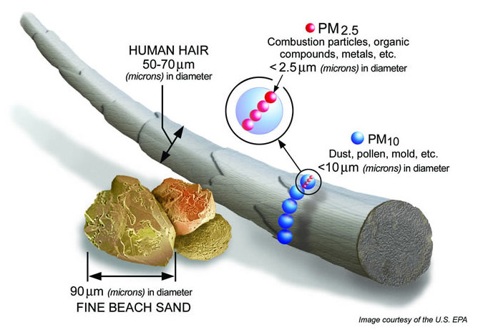
PM₁₀ and PM_{2.5}

Slide 6
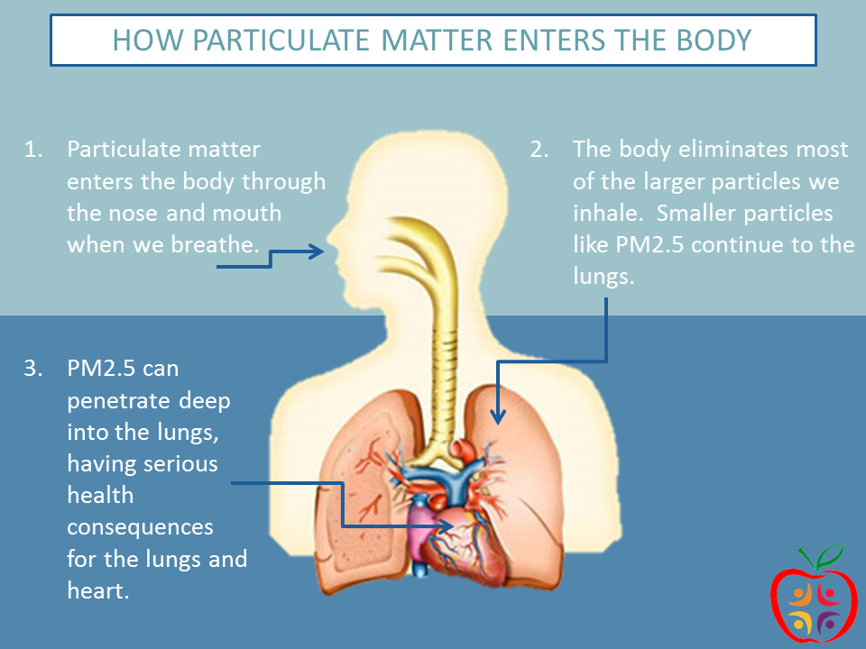

Slide 7
Some Facts about Air Pollution
Air Pollution is No. 1 environmental killer;
Kills more than 8 millions each year;
Over one third of Americans breathe unhealthy air;

Slide 8
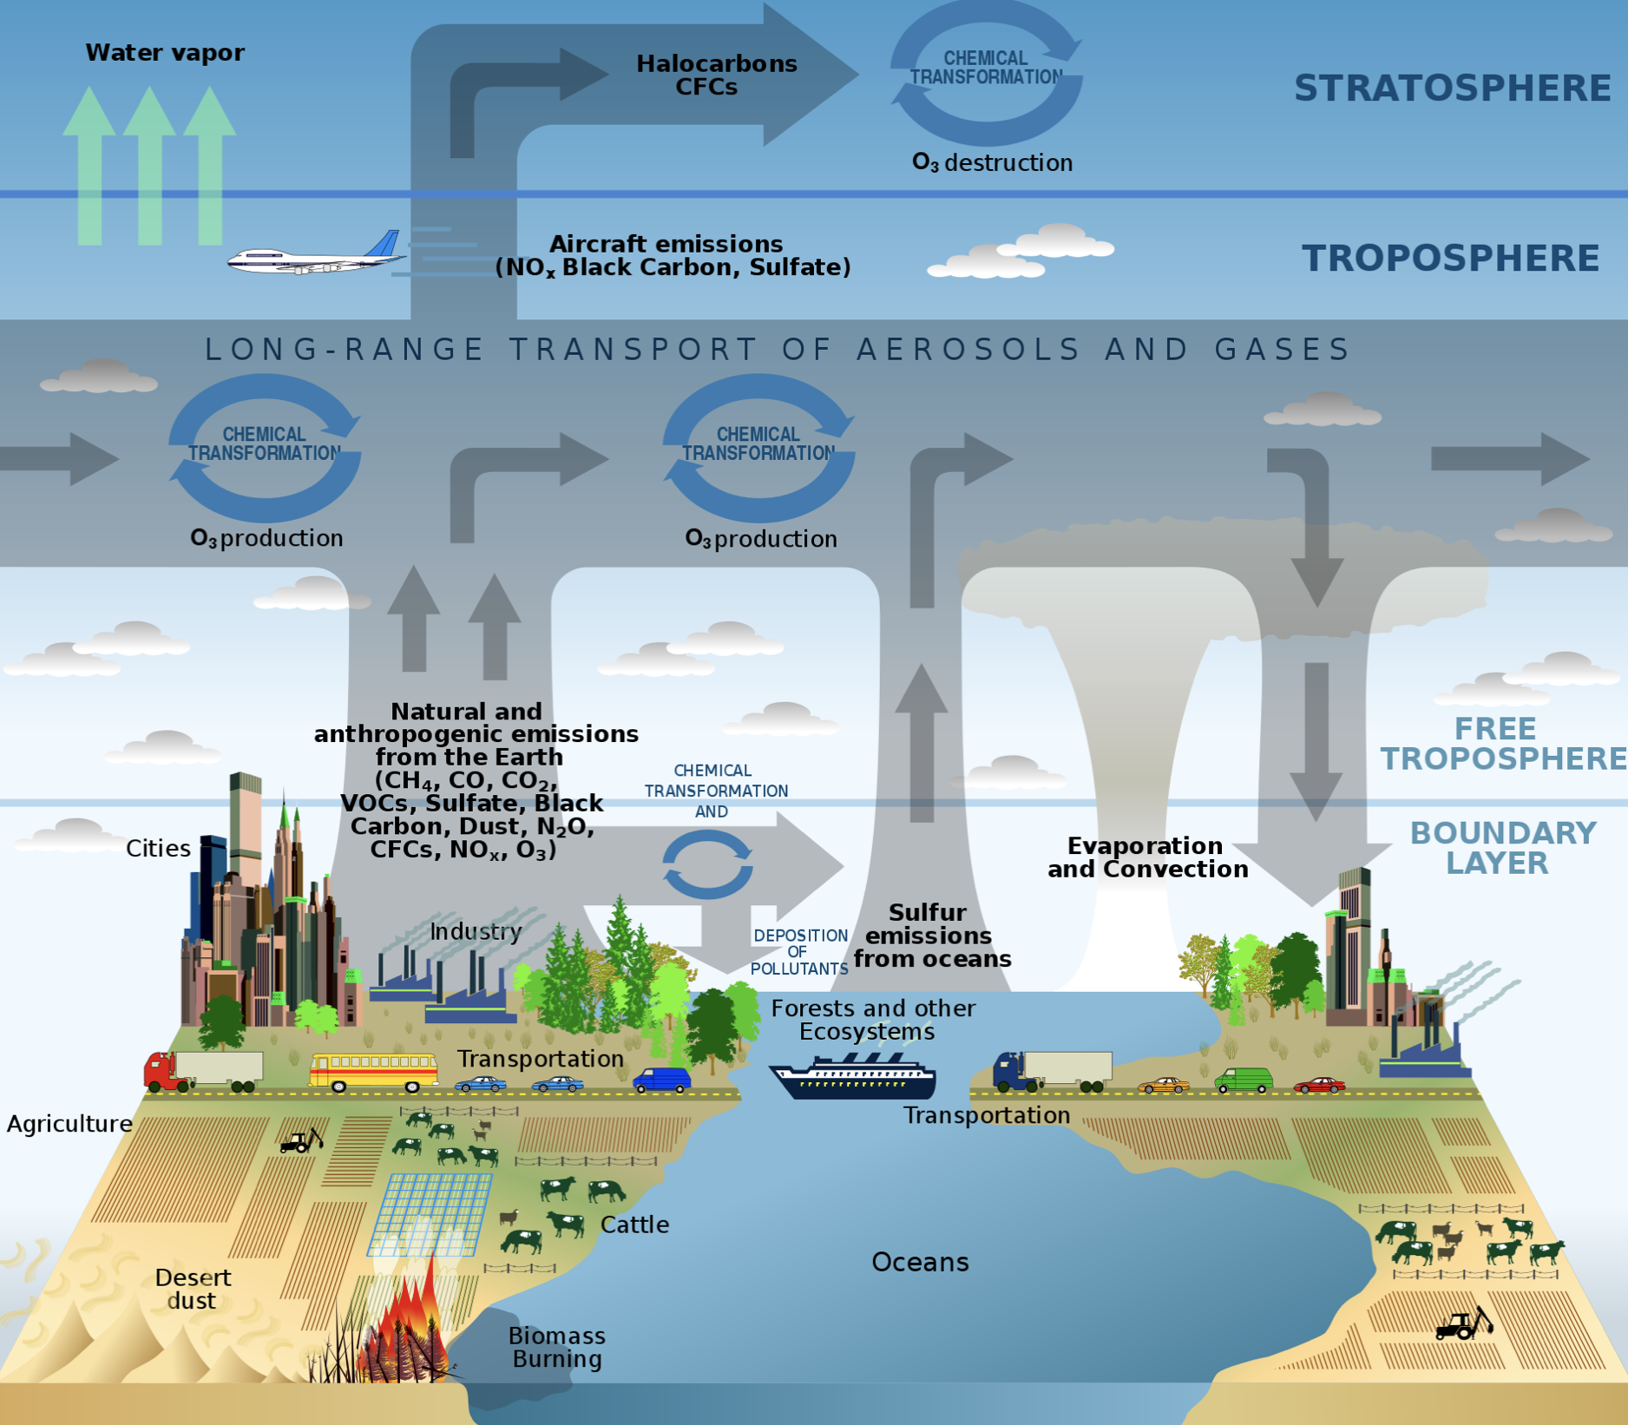
Chemistry of the Atmosphere
Additional Courses at Mason:
CLIM319: Air Pollution
CLIM438: Atmospheric Chemistry
CLIM769-002: Aerosols
(Picture in the public domain)

Slide 9
Simple Eulerian Box Model
Inflow
Outflow
Chemical Transformation
Emission
Deposition

Slide 10
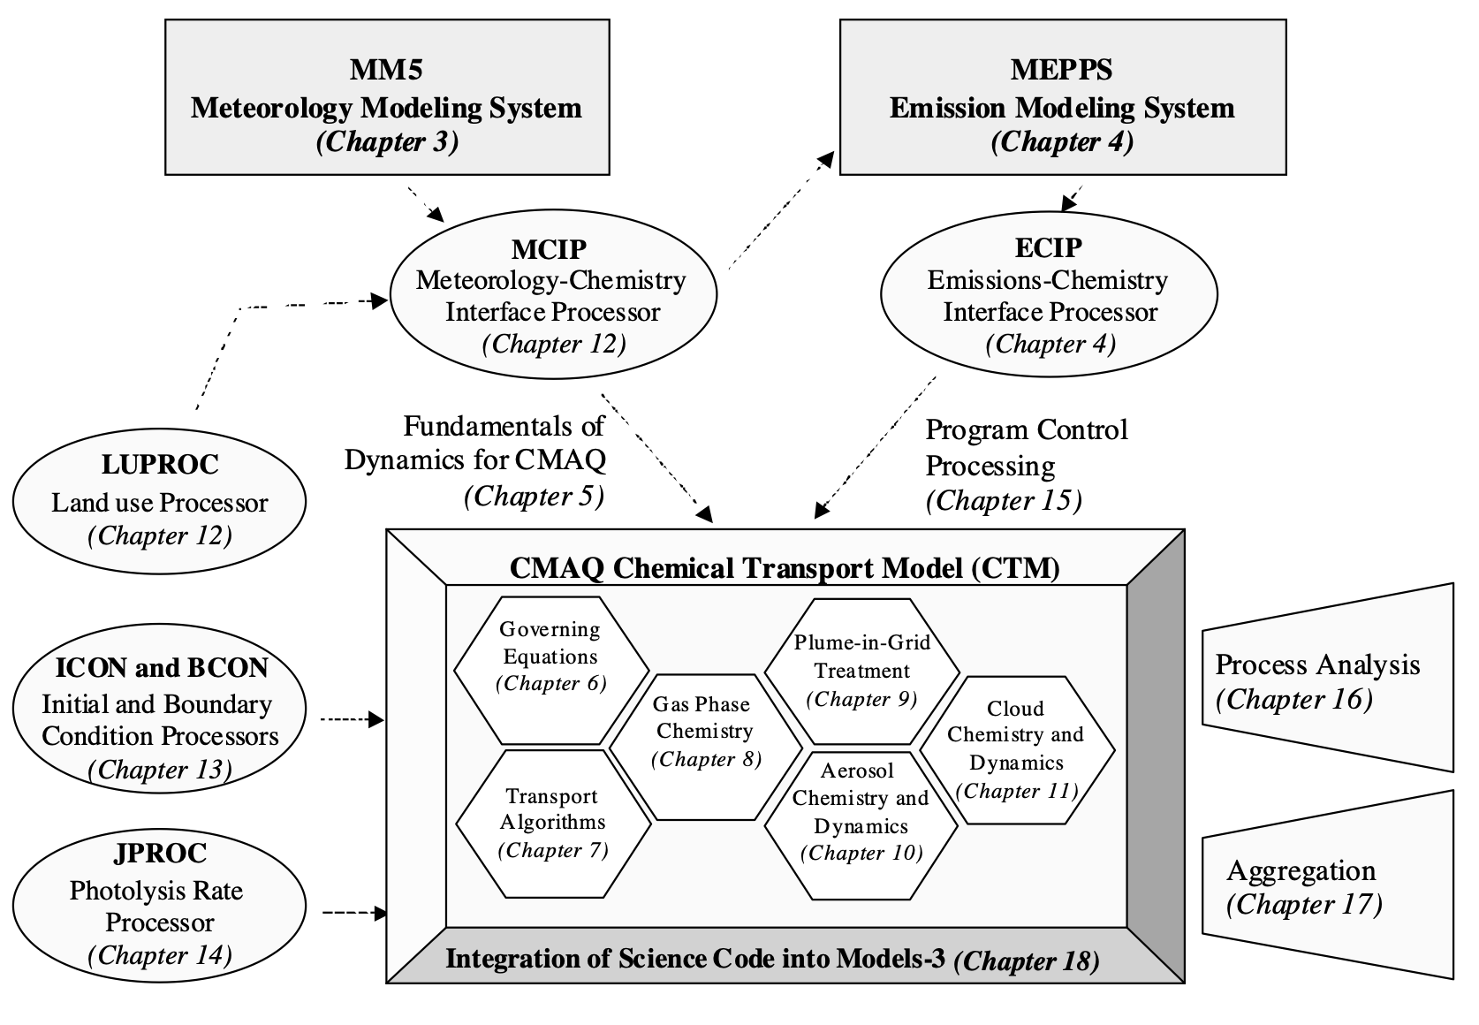
Comprehensive Air Quality Models
CMAQ – Community Multiscale Air Quality model
(Source: EPA)

Slide 11
Regional Air Quality Modeling
Air Quality Model
Meteorology Model
Emission Model

Slide 12
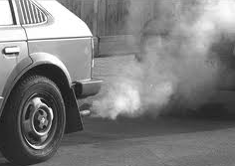
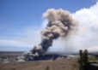


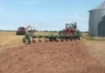
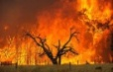

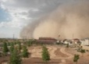
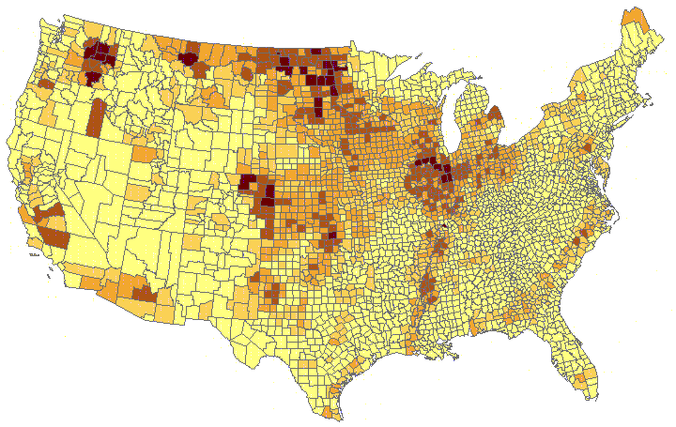
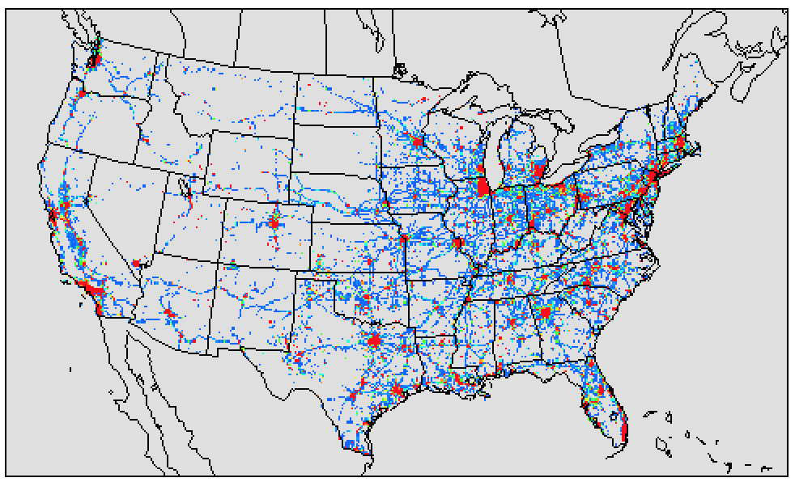
Emission Modeling
Real World Emissions
Emission Inventories
Model-ready Emission

Slide 13
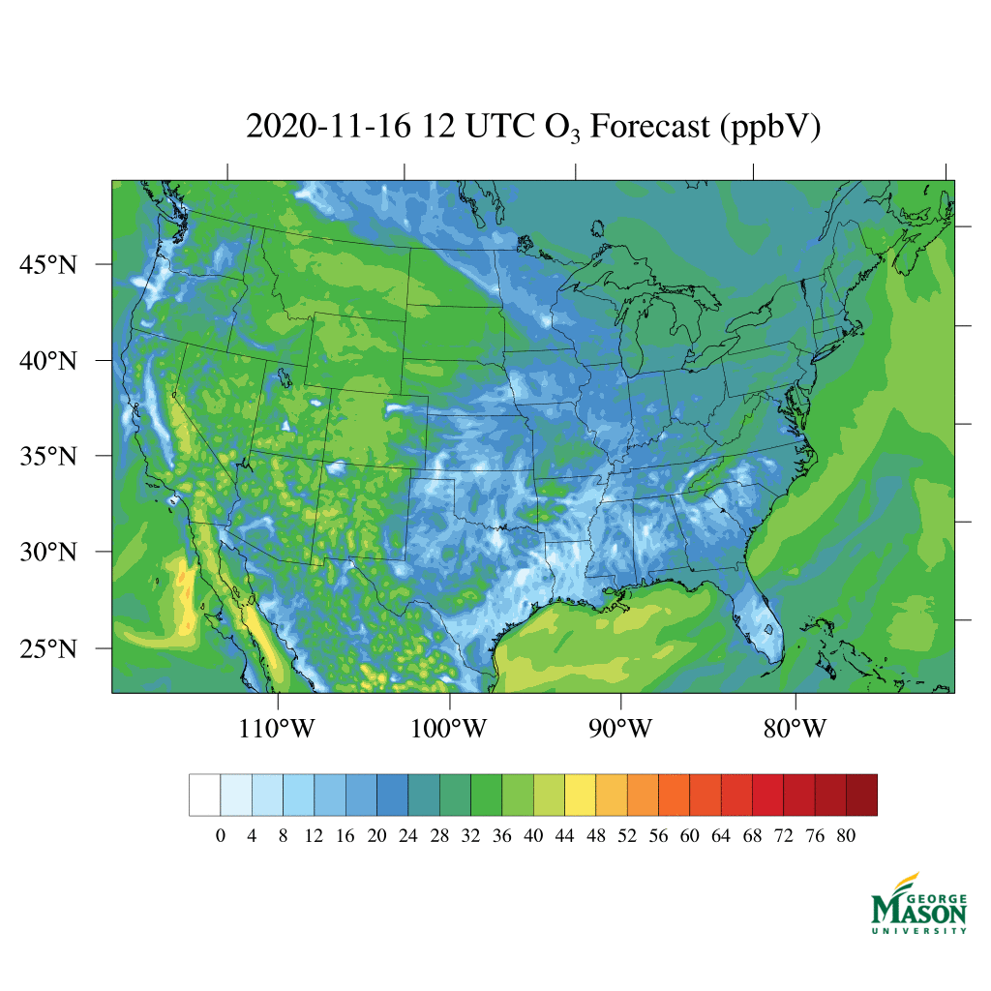
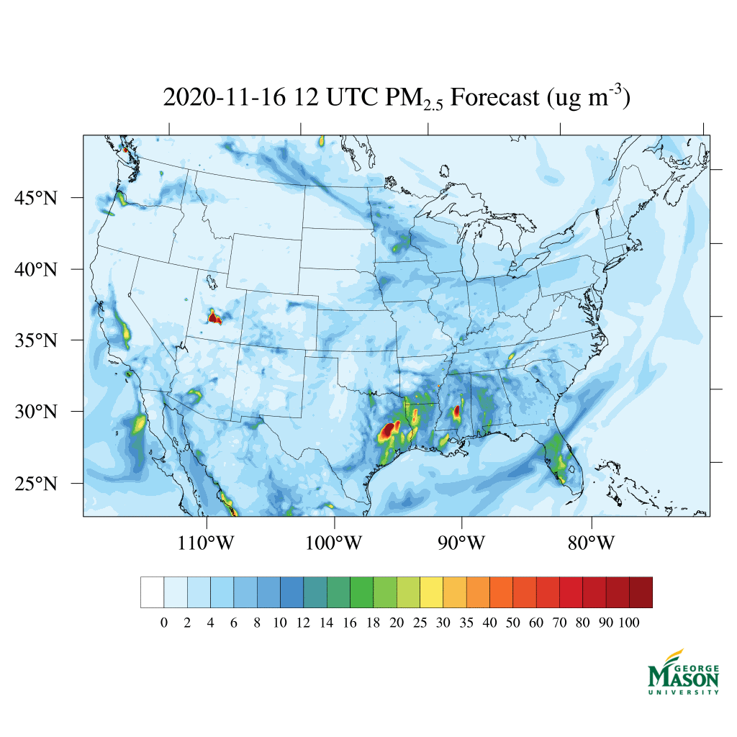
GMU Air Quality Forecast Capability
Operated by GMU;
Provides national numerical air quality guidance for ozone and PM_{2.5} (particulate matter with diameter < 2.5 mm);
O₃ Forecasting
PM_{2.5} Forecasting

Slide 14
Application 1. Impact of the Social Events on US Air Quality
Great Depression
Starting – Ending time: December 2007 – October 2009;
Cause: Bursting of the housing bubble in 2007, followed by a subprime mortgage crisis in 2008;
Impacts:
Unemployment rate: 4.7% in Nov 2007 → 10.1% in Oct 2009.
Income level: dropped to 1996 level after inflation adjustment;
Poverty rate: 12% → 16% (50 millions);
GDP: contract by 5.1%;
Worst economic recession since the Great Depression
Question: What does it mean to Air Quality (and Emissions)?

Slide 15
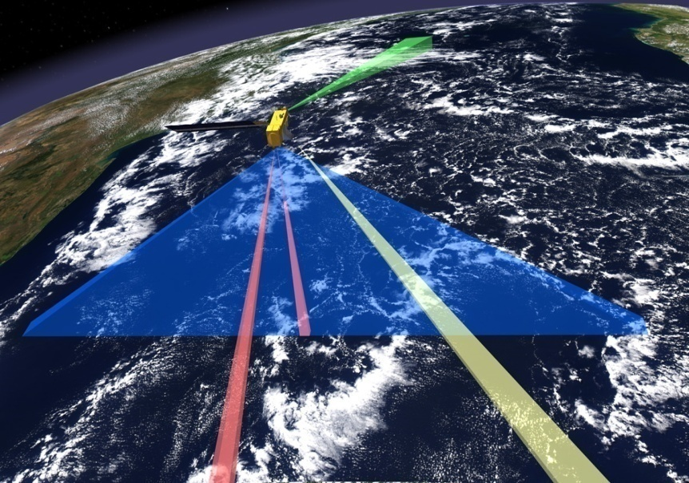
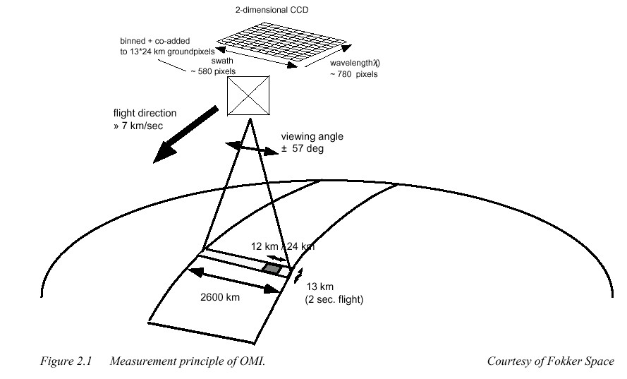
Ozone Monitoring Instrument (OMI)
One of four sensors on the EOS-Aura platform (OMI, MLS, TES, HIRDLS)
Launched on 07-15-04
Courtesy of OMAR Torres
Instrument Characteristics
-Nadir solar backscatter spectrometer
-Spectral range 270-500 nm (resolution~0.6 nm )
Spatial resolution: 13X24 km footprint
Swath width: 2600 km (global daily coverage)
13:45 (+/- 15 min) Local equator crossing time (ascending node)
Data Quality Control
- VCD quality flag;
- Cloud fraction;
Row Anomaly;
Outliners (5% at each end)

Slide 16
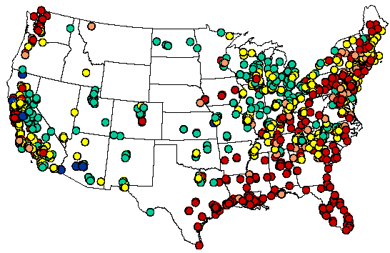
AQS: EPA Ambient NO2 Monitoring
Method: Chemiluminescence
Interferences with PAN, O3 and alkyl nitrates
Uncertainty higher at lower end
Select early morning rush hours (6-9AM): higher values and less photochemistry

Slide 17
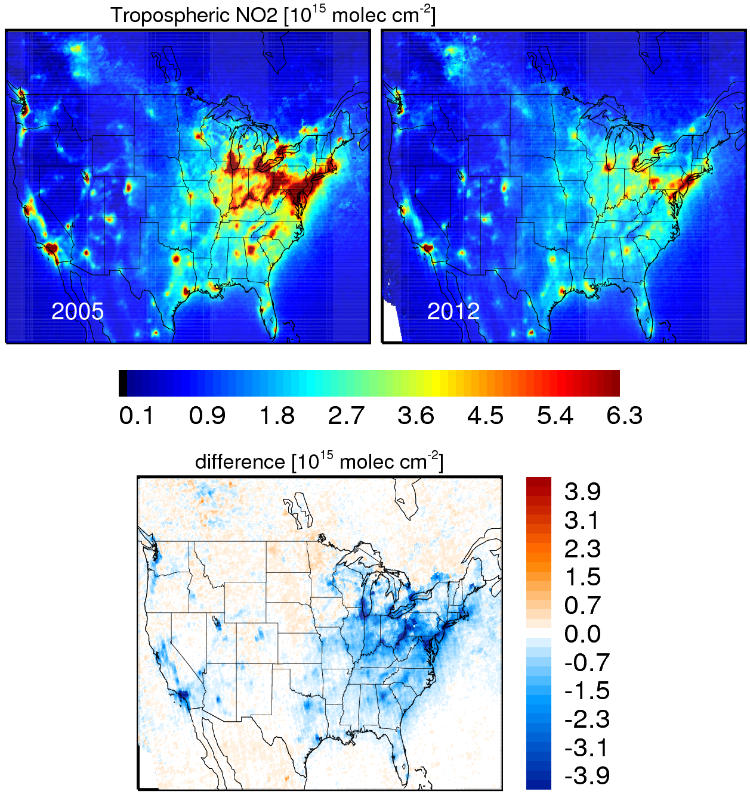
OMI Observed NOx Change (July)
Contributed by Lok Lamsal

Slide 18
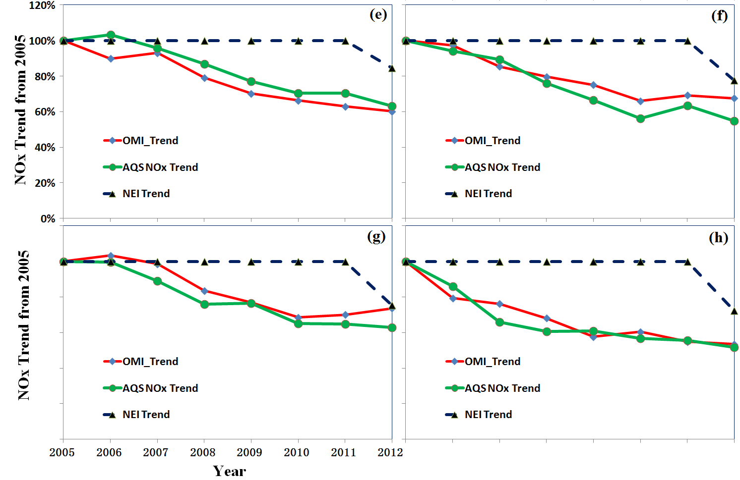
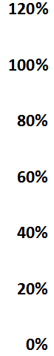
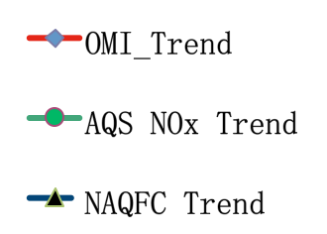
Inter-Comparison of OMI, AQS and NAQFC Model
Los Angeles
New York
NOx Change from 2005 Level (%)
Philadelphia
Washington, DC
(Source: Tong et al., 2015)

Slide 19
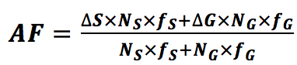
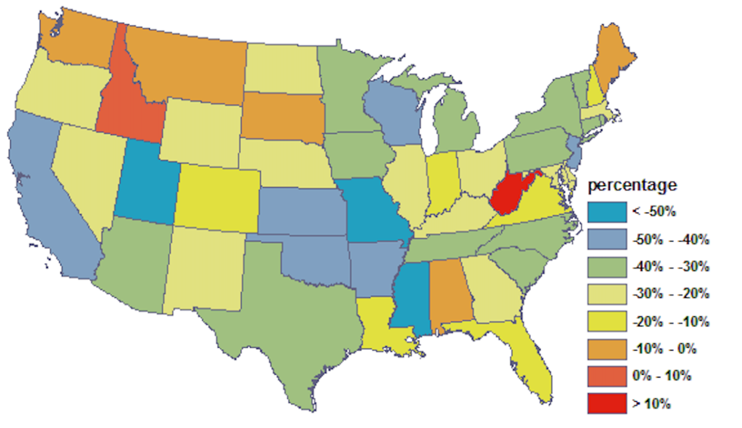
Rapid Refresh of NO_{x} Emissions
Question: Can satellite and ground data be used to rapidly refresh NOx emissions?
Fusing ground and satellite data:
State-level Adjustment Factors
AF – Adjustment Factor
△S – Change in Satellite data;
△G – Change in Ground data;
N_{S} – Satellite sample size;
N_{G} – Ground sample size;
f_{S} – Satellite weighing factor;
f_{G} – Ground weighing factor;
(Source: Tong et al., GRL, 2016)
(2005 to 2012)
19

Slide 20
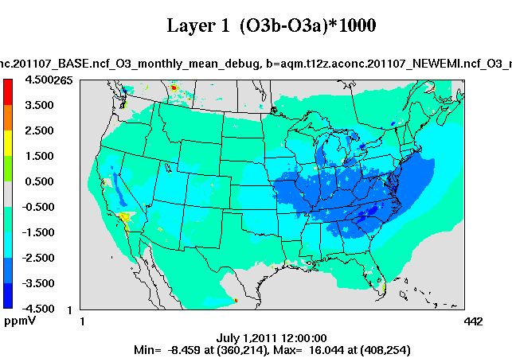
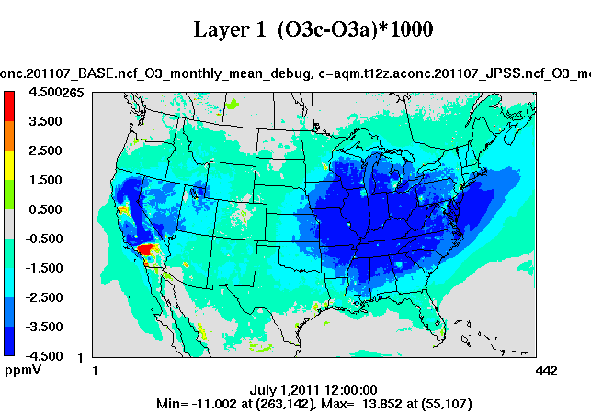
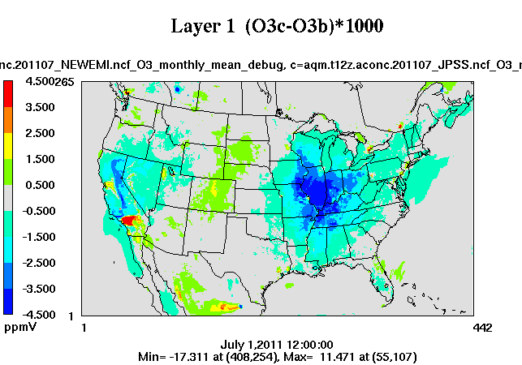
Recession Impact on US Air Quality
Business As Usual (2011-2005)
Recession (2011-2005)
O₃ Changes Caused by Recession
Quantifying Recession Impact:
BAU: EPA Projection;
Recession: Observed Changes;
Difference: Recession impact.
(Source: Tong et al., GRL, 2016)
Notes:
We use this approach to quantify the impact of the 2008 Great Recession on the US air quality.
The Recession impact is estimated from the difference between two model simulations using the Business as Usual and the Economic Recession scenarios. IN the Business as Usual case, the EPA emission projection for the Cross-State Air Pollution Rule (CSAPR) is used to represent the “would-be” emission level without the recession. IN the recession case, the observed emission trends are used to represent the actual emissions changes.
In both cases, surface ozone concentration decreased from 2005 to 2011 as a results of reduced emissions. The difference between business as usual and recession, which is shown at the botthom, showed theRecession has reduced ozone further in the eastern US and the Pacific west. The ozone concentration increased in southern California, due to reduced titration by emitted NO. There was also an increase in central US, which is caused by increased emissions from the oil and gas operations in this region

Slide 21
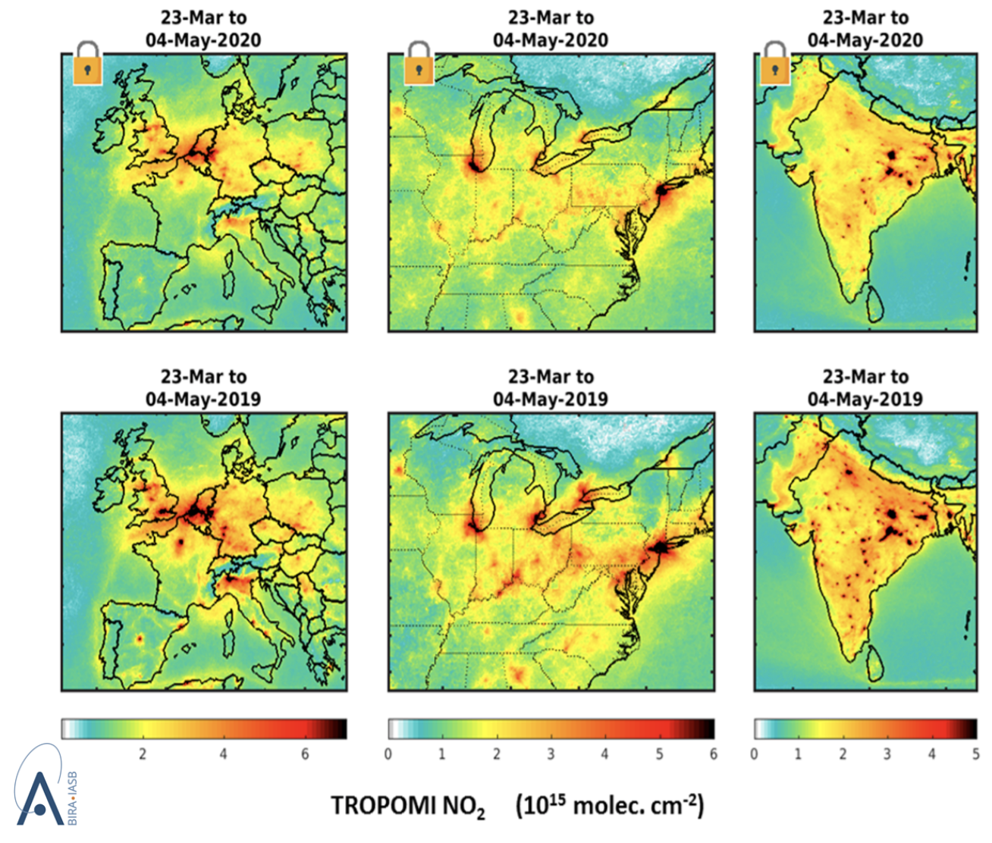
World Air Quality during COVID-19
(Source: European Space Agency)

Slide 22
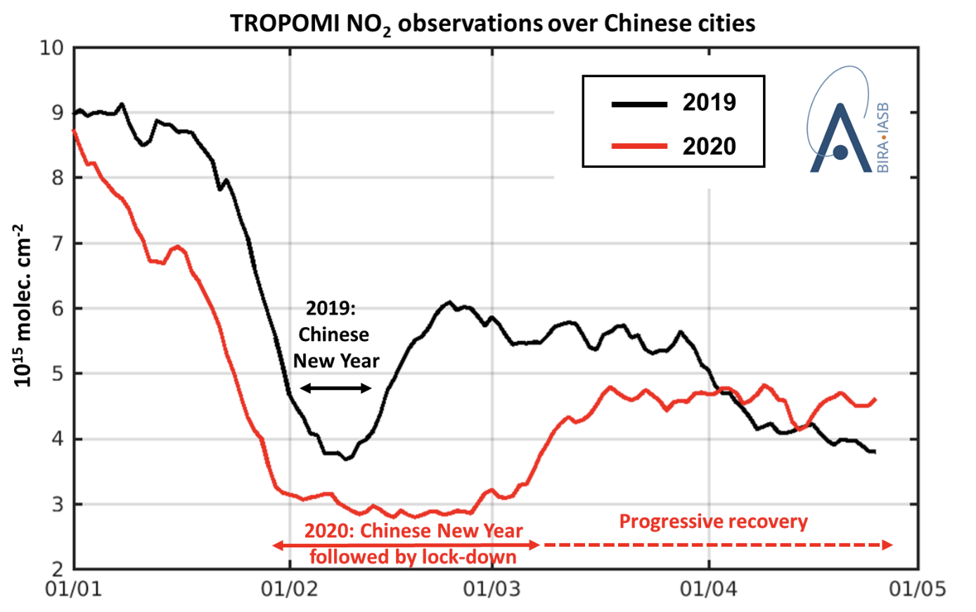
Post-COVID-19 Air Quality
(Source: European Space Agency)
Emissions in China returned and surpassed historic levels quickly after the lifting of lock-down.
Similar trends observed in the U.S. during the 2008 Recession (Tong et al., 2015)

Slide 23
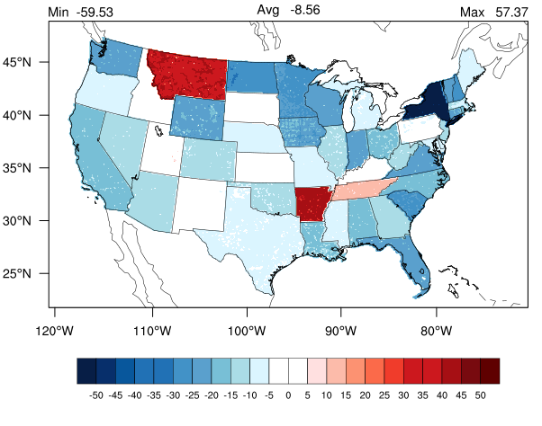
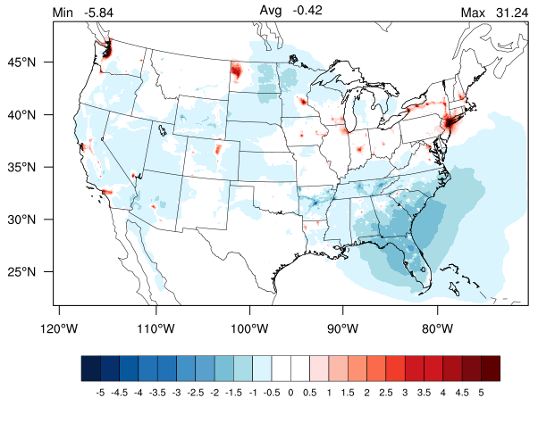
COVID-19 Impacts on U.S. Air Quality
(Patrick Campbell, GMU/NOAA)
Using emission changes based on satellite and ground data, we use the Community Multiscale Air Quality (CMAQ) model to quantify COVID-19 effects on U.S. air quality.
Oxides of nitrogen emission changes (%)
Ground-level ozone changes (%)
Decreases
Increases
Decreases
Increases
March 15-April 15, 2020

Slide 24
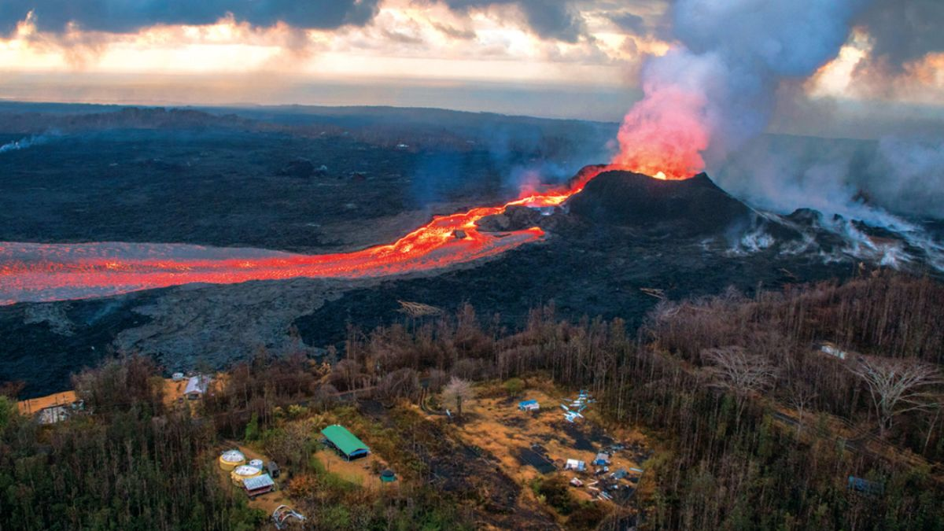
Kilauea Volcanic Eruption - Hawaii
(Source: Earther)
Notes:
NOTE: notes not added—please add to your slide.

Slide 25
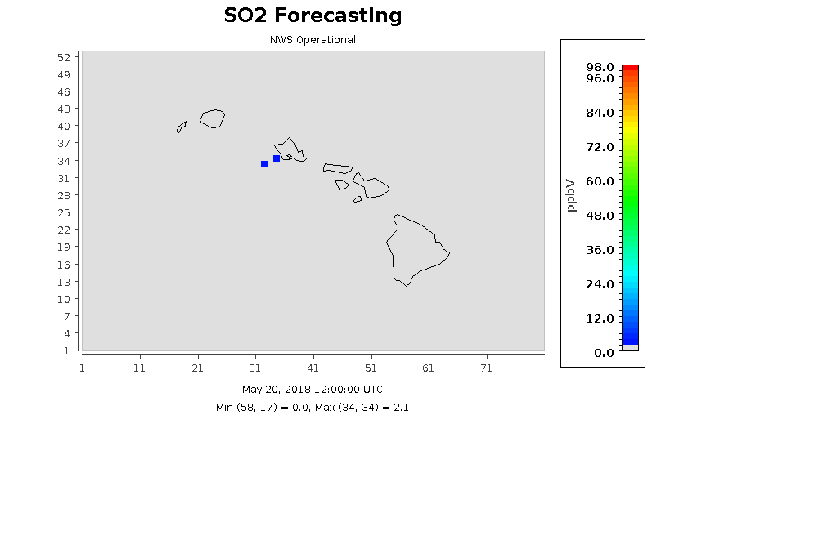
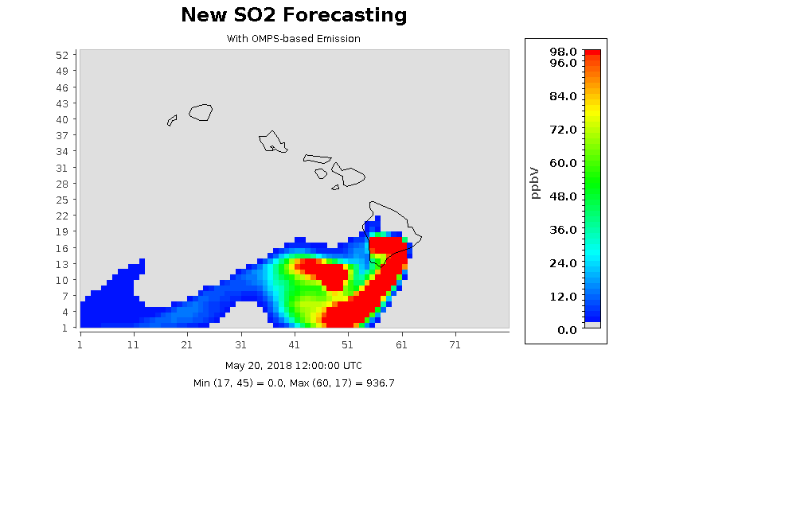
Sulfur Dioxide (SO₂) Prediction of
the Kilauea Volcanic Eruption
Without Volcanic Emissions
With Volcanic Emissions
25
(Source: Tang et al., 2020)
Notes:
NOTE: notes not added—please add to your slide.

Slide 26
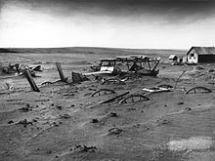
The “Dust Bowl”
Causes: Extended droughts and poor land management;
SD-1936
(Source: USDA)
Notes:
Homestead Acts: settlement over the Plains for agriculture ;
“Rain follows the plow”: unusually wet climate;
New agricultural machinery: Deep plowing, eliminating native grass;
Favorable dust storm conditions during 1930s drought

Slide 27
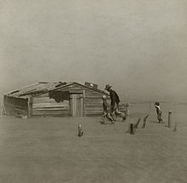
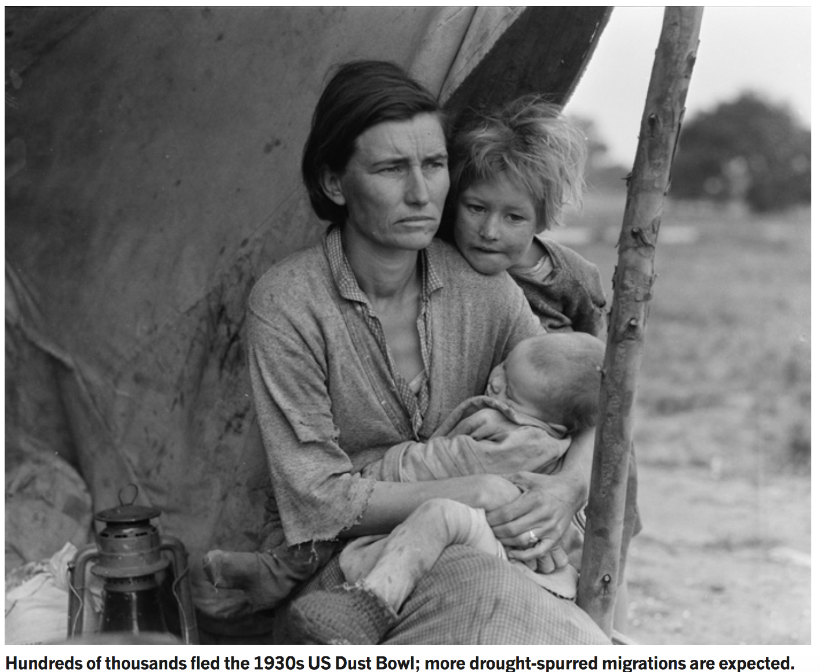
The “Dust Bowl”
Impacts:
Stripped 75% of top soils over thousands of farms;
Destroyed agriculture and ecosystem (~1950s);
> 500,000 lost homes and communities;
"And then the dispossessed were drawn west--from Kansas, Oklahoma, Texas, New Mexico; from Nevada and Arkansas, families, tribes, dusted out, tractored out... They streamed over the mountains, hungry and restless--restless as ants, scurrying to find work … anything, any burden to bear, for food. The kids are hungry. We got no place to live…”
-- John Steinbeck in the Grapes of Wrath

Slide 28
Another “Dust Bowl”?
Central U.S. plains saw severe droughts about once or twice a century over the past 400 years (Woodhouse & Overpeck, 1998).
This recurring trend may be enhanced global climate change (Schubert et al., 2004).
Global warming → Precipitation shift from subtropics, greater evaporation, less snow/ice, and earlier spring → amplify the effects of natural climatic variations → intensified droughts and “dust-bowlification” (Romm, 2011).
(Source: Romm, Nature, 2011)

Slide 29
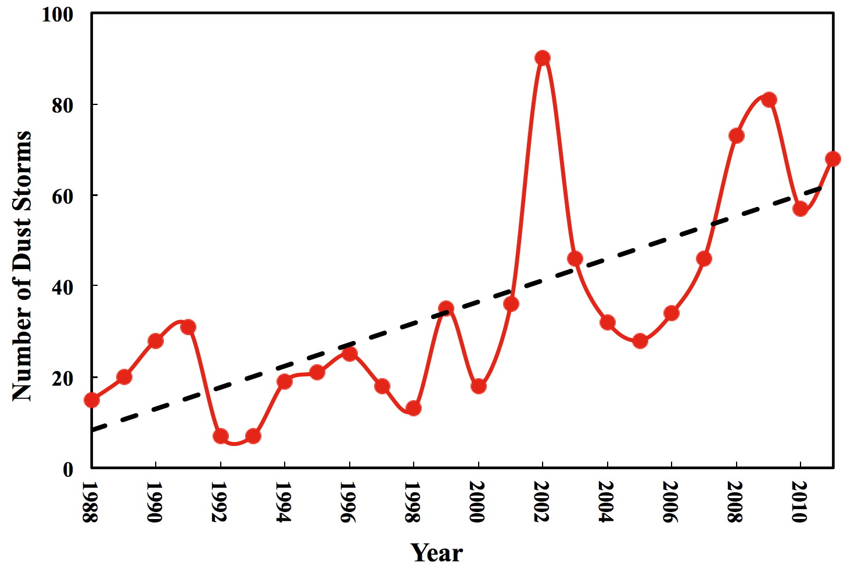
Long-term Dust Trend
20 Giant Storms in 1990s → 48 Storms in 2000s;

Slide 30


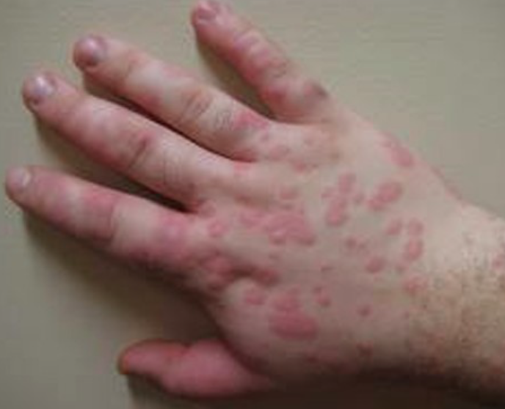
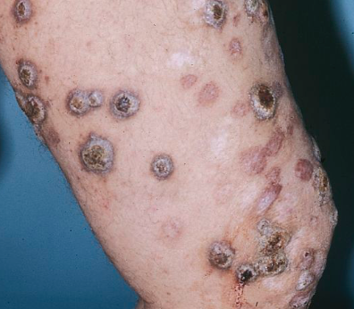
Valley Fever (Coccidioidomycosis)
Infection caused by inhaling the soil-dwelling fungus Coccidioides
Coccidioidomycosis:
Lung infection;
Disseminated Coccidioidomycosis: Bloodstream transport to Skin, Brain, Nerve etc
(Source: thinklink.com)
2000 – 2011: 800% Increase in Infection;
3000 deaths caused by Valley Fever;
Notes:
“San Joaquin Valley fever” or “desert rheumatism.” The term “Valley fever” usually refers to Coccidioides infection in the lungs, but the infection can spread to other parts of the body in severe cases (this is called “disseminated coccidioidomycosis”).

Slide 31
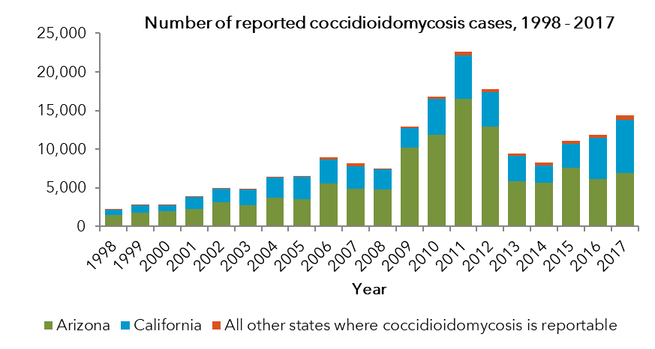
Mysterious Spike in Valley Fever
(Courtesy of Orion McCotter)
Rates in the United States have increased dramatically
~10,000-20,000 cases reported to public health annually
>95% of cases are from Arizona and California
800% Increase in Infection;
5,000 – 20,000 infections and 200 deaths each year;

Slide 32
Collocation of
Dust Storms and Valley Fever
(Tong et al., 2017)

Slide 33
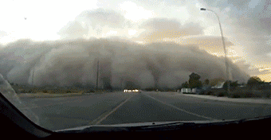
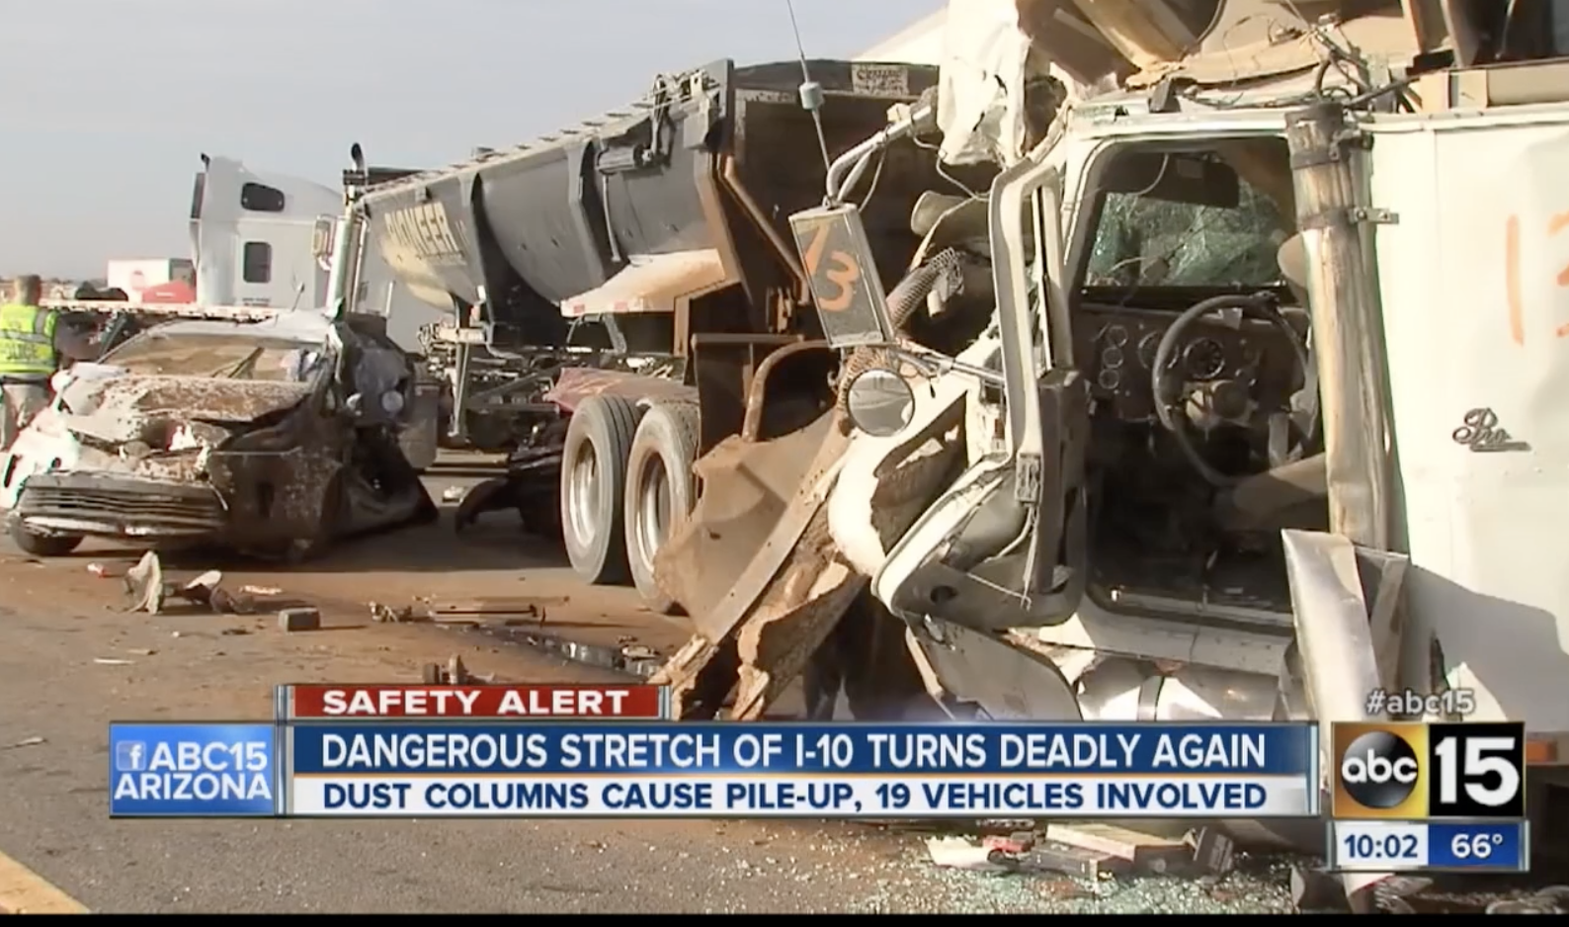
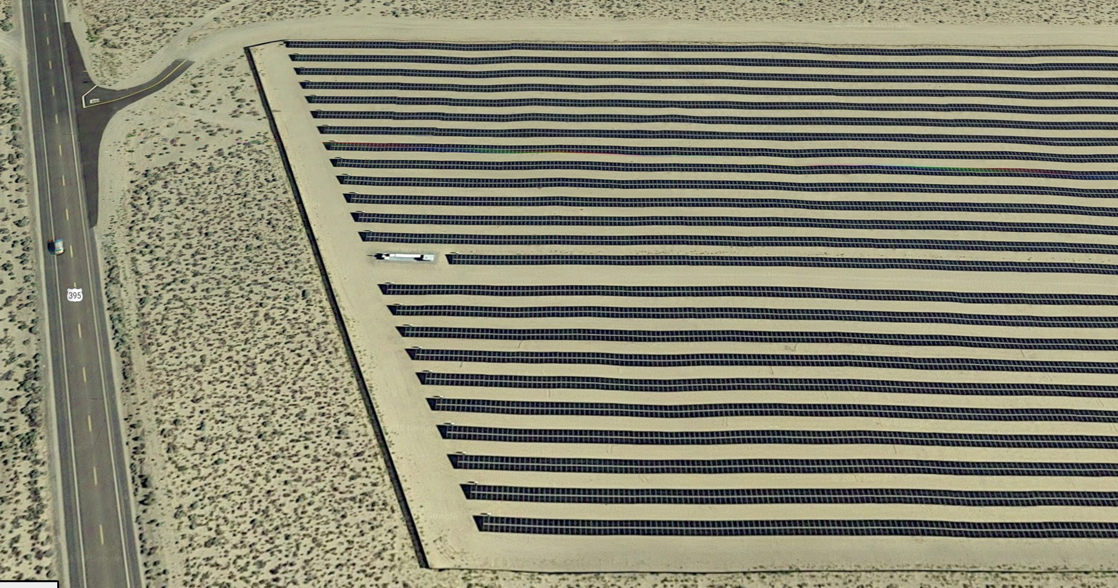
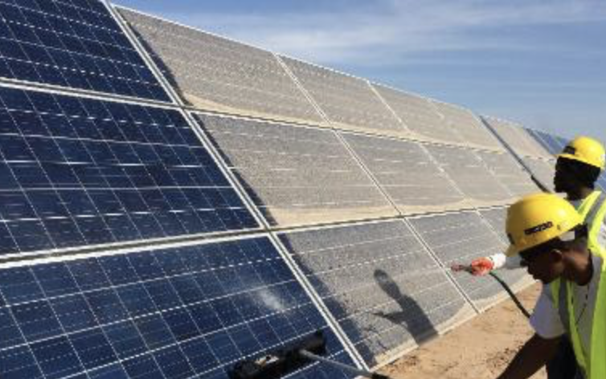
Highway Safety, Solar Power, Agriculture…
Highway traffic accidents caused by visibility loss and high wind
(Source: Giphy)
Dust deposition reduces power generation efficiency of solar farms
Notes:
“San Joaquin Valley fever” or “desert rheumatism.” The term “Valley fever” usually refers to Coccidioides infection in the lungs, but the infection can spread to other parts of the body in severe cases (this is called “disseminated coccidioidomycosis”).

Slide 34
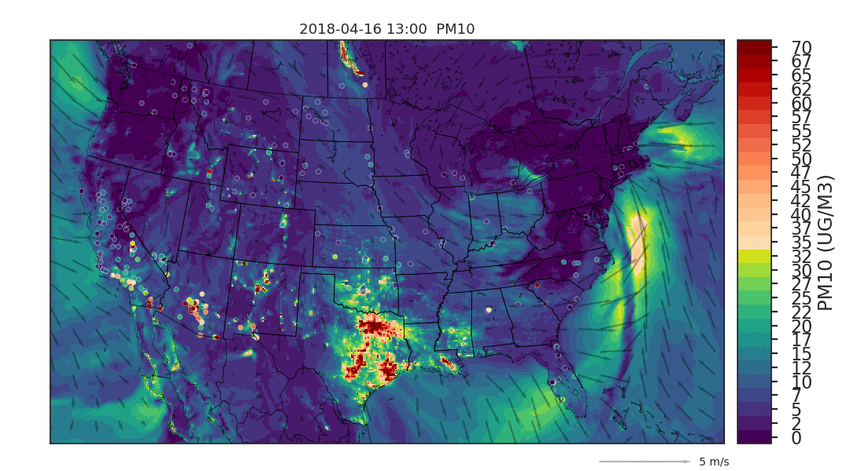
On the day Americans file tax returns, there are always some big dust storms.
Tax-Day Dust Storms
(Tong and Tang, EM, 2018)

Slide 35
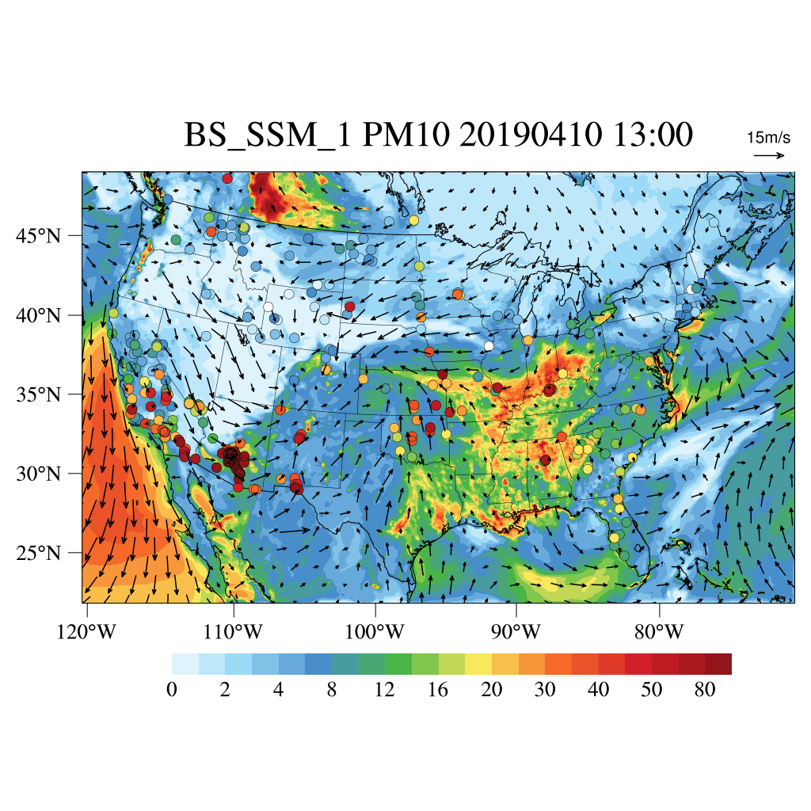
CMAQ Dust Simulation with Baker-Schepanski Map
Surface PM₁₀ during the Dust Storm

Slide 36
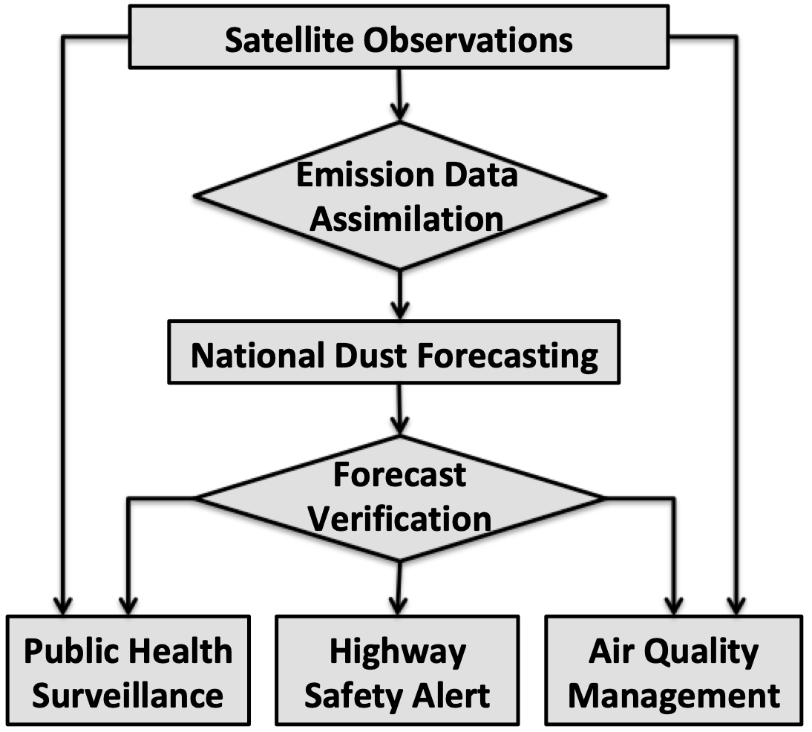









Bring Science to Services
Use satellite-aided forecasts to:
Support three dust services:
Valley fever surveillance;
Highway safety alert;
Air quality management;

Slide 37
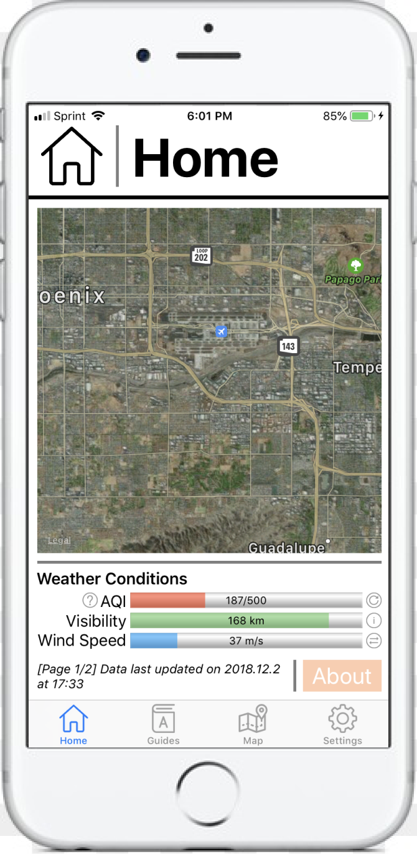
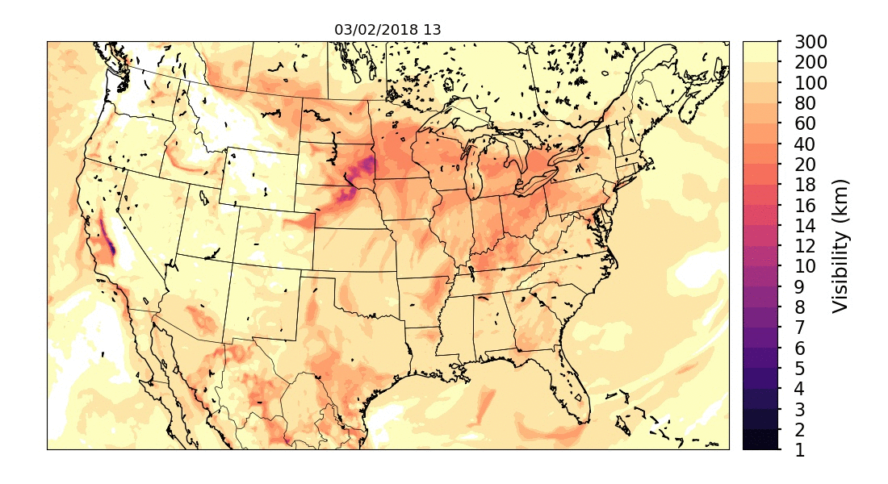
Dust Forecasting for Highway Safety
Highway dust forecasts:
Visibility
High Wind
Dust Concentration
Inhalable Particle Concentration
DustWatch App:
Citizen Scientist Project
Use dust forecasts
Real-time dust alerts
(Contact Dust App. Team:
dustapp2018@gmail.com)
(Courtesy: Barry Baker)

Slide 38
CMAQ Lab: Wildfire Forecasting
Observations of the 2020 Gigafire;
https://www.star.nesdis.noaa.gov/smcd/spb/aq/AerosolWatch/
Install and Run the CMAQ model for the wildfire case;
https://docs.google.com/document/d/1_B4M4g4SqBTfdQFOb_vMq2ecPF-Z7Agw9YwFFzGRG4Y/edit?usp=sharing
3) Assignments:
Read about the western fires this year, and write about 3-4 unique things about these fires.
Finish running your CMAQ wildfire forecasting;
Visualize your own results (hint: change this line in run_plot.sh): export aconc_dir="/home/cmaq/dtong/data/output"

